Slide 1



RATHINAM COLLEGE OF ARTS AND SCIENCE DEPARTMENT OF RSMART – RCAS UG – B.Sc. – CS (CTIS) Cyberninja: Social Media Tracking Tool
THIRD REVIEW – 26/02/2025
PRESENTED BY,
SRI BRINDHA S
VIMAL D
RAHUL R
VINAYASREE G
GUIDED BY,
Mr. MOHAMED ATHFAN D

Slide 2
CONTENTS
3. INTRODUCTION
4. OBJECTIVE
5. ABSTRACT
6. METHODLOGY
7. WORKFLOW
8. DEPLOYMENT FLOWCHART
9. TIMELINE
10. PROJECT STRUCTURE

Slide 3
INTRODUCTION
One social media tracking tool where it scans for over 300 platforms is Cyberninja. It can provide one with online activities, and its scanning services offer a network besides other platforms. The features of this tool include anonymous browsing with Tor, allowing proxy support, and batch processing. In such ways, digital footprints are searched and analyzed efficiently using Cyberninja, which proves to be an important element in investigating online presence for various scenarios.

Slide 4
OBJECTIVE
The Cyberninja platform is designed to provide an effective tool for tracking and analyzing online activity by searching usernames across a wide range of social media platforms and web spaces. It will thus identify suspected attackers or victims by uncovering relevant accounts and digital footprints, maintaining user privacy with attributes such as anonymo-browser and proxy support. It also provides options for versatile reporting and analysis to make it simpler and facilitate an investigation process in digital forensics and cyber investigations.

Slide 5
ABSTRACT
Cyberninja is a social media tracker that identifies the possibility of attackers or victims by looking up usernames on more than 300 platforms. The tool scans social networks and online platforms for a relevant account while also providing features like anonymous browsing through Tor, proxy support, and batch processing to handle multiple usernames at once. Cyberninja offers export options in CSV or JSON format, enabling extensive reporting and analysis. The flexible settings, especially site-specific searches, timeouts, and offline mode, make sure that it is basically an indispensable tool to track online activities and investigate digital footprints efficiently.

Slide 6
METHODOLOGY
Development Approach:
1.Requirement Analysis
2.Programming Language Selection
Integration Process:
1.Testing
2.Automation Scripts
3.Publishing in PyPi (pip)

Slide 7
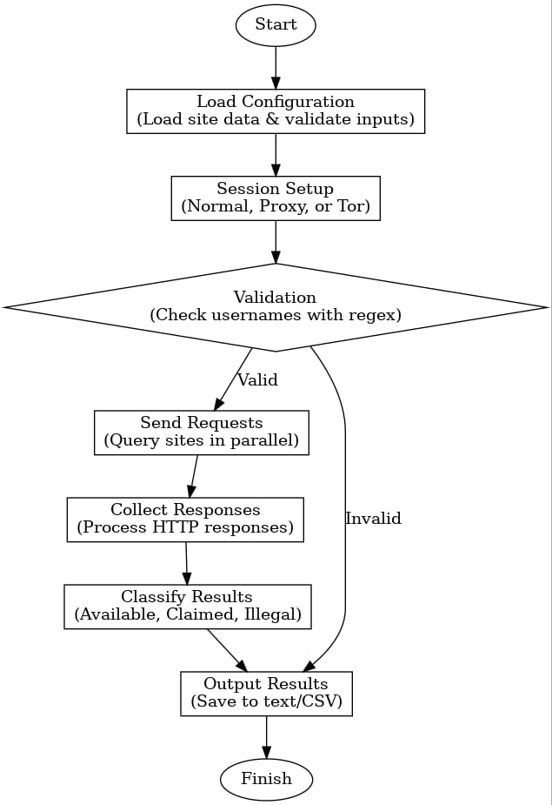
WORKFLOW

Slide 8
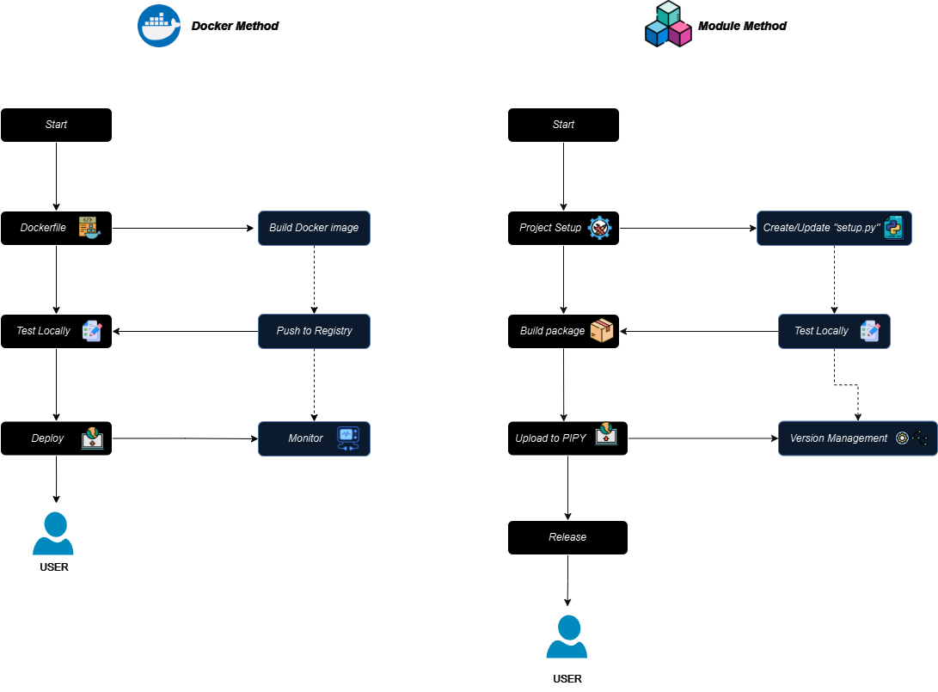
FLOWCHART

Slide 9
TIMELINE
Week 1:
-Planning and Requirement Analysis
Week 2-3:
-Development of Automation Scripts
Week 4-5:
-Integration of Additional Tools
-Configuration Management Implementation
Week 6:
-Testing and Validation
- Documentation and Presentation Preparation
- Final Review and Deployment

Slide 10
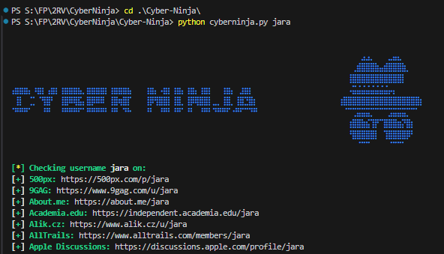
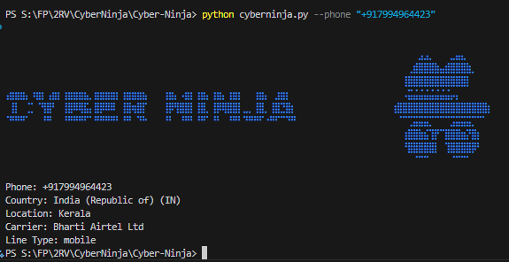
PROJECT STRUCTURE
OUTPUT FOR NAME
OUTPUT FOR NUMBER

